Slide 1
End of Unit 1
Anatomy and Physiology

Slide 3
Collect the following items before class begins
Lab Fee Sheet from the Desk
Notes Sheet from the Desk
Textbook from the Back of the Room

Slide 4
Mrs. Brown’s website
https://mbrownahs.weebly.com/
Have your parents complete the Parent Contact Form
All notes will also be posted here

Slide 5
Common Questions
Can you survive without homeostasis?
Any reason why homeostasis shouldn’t occur?
What could make homeostasis stop?
Does homeostasis make mistakes?
Is there a specific disease that prevents homeostasis from occurring?

Slide 6
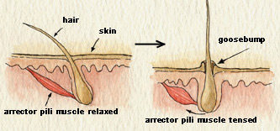
Common Questions
What do goosebumps have to do with homeostasis?
Is body hair standing on edge homeostasis?

Slide 7
Common Questions
Breathing & Homeostasis

Slide 8
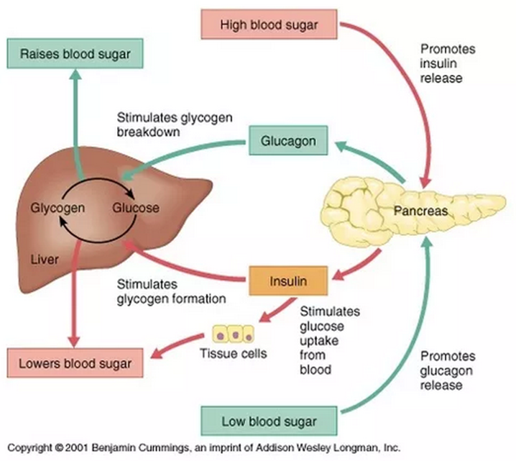
Common Questions
Glucose in the Bloodstream

Slide 9
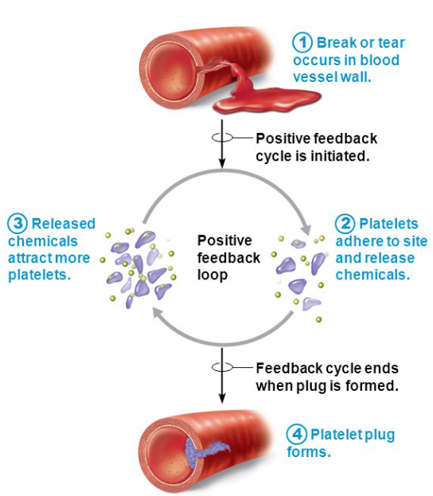
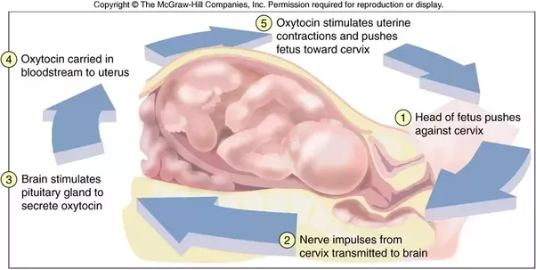
Common Questions
Positive Feedback- Amplifying Response

Slide 10
Common Questions
How do other organisms use homeostasis?
In order for an organism to exist, it needs a way to keep its insides in stable conditions in relation to external stimuli.
Many organisms have similar biological processes to humans, and we will compare that throughout the year, especially with

Slide 11
Examples of Homeostasis
Body Temperature
Blood Pressure
pH of blood
Glucose concentration
Heart rate
Breathing rate
Fighting off illnesses
Water Balance
Toxins (Urinary System)
Hormone Levels

Slide 12
Worksheet Questions
Temp increases, so blood vessels dilate to move blood flow closer to the surface to release more heat
Temp decreases, so our body tries to retain heat
Blood clotting, more platelets sent to the injury site
Childbirth, oxytocin and contractions increase
High blood pressure, signal to slow down the heart rate to release the pressure
Overweight people have difficult time keeping the weight off… WHY?
https://chriskresser.com/why-its-so-hard-to-lose-weight-and-keep-it-off/
Start @ 14:46

Slide 13
What have we looked at so far…
Body Regions
Body Planes
Relative Positions
Today… we are going to look at BODY CAVITIES
Body cavity- underlying organs and other membranes that are contained in these spaces/areas

Slide 14
Dorsal and Ventral
Dorsal (back)
Cranial Cavity (Brain)
Vertebral Canal (Spinal Cord/Vertebrae)
Ventral (front)
Thoracic Cavity (Ribs)
Abdominopelvic cavity (abdomen + pelvis)
Diaphragm (separates thoracic from abdominopelvic)

Slide 15
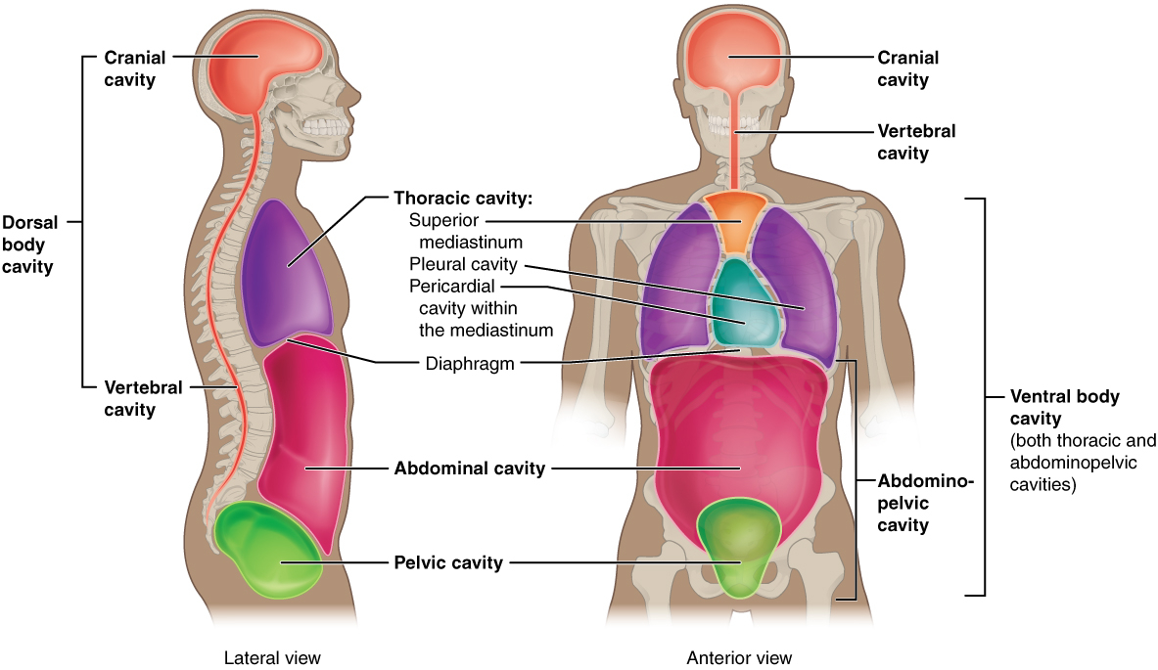

Slide 16
The Heart & Lungs
Pericardial Cavity (Heart)
Pleural Cavity (Lungs)

Slide 17
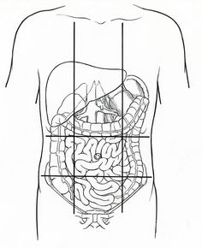
Abdominopelvic Regions
Abdominopelvic region is split into 9 regions

Slide 18
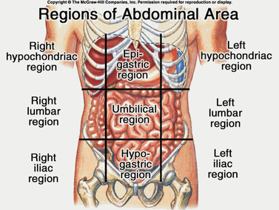
In the middle…
Umbilical
Large and small intestine
Epigastric
Stomach, Large Intestine, Liver
Hypogastric
Small intestine, urinary bladder, internal reproductive organs

Slide 19
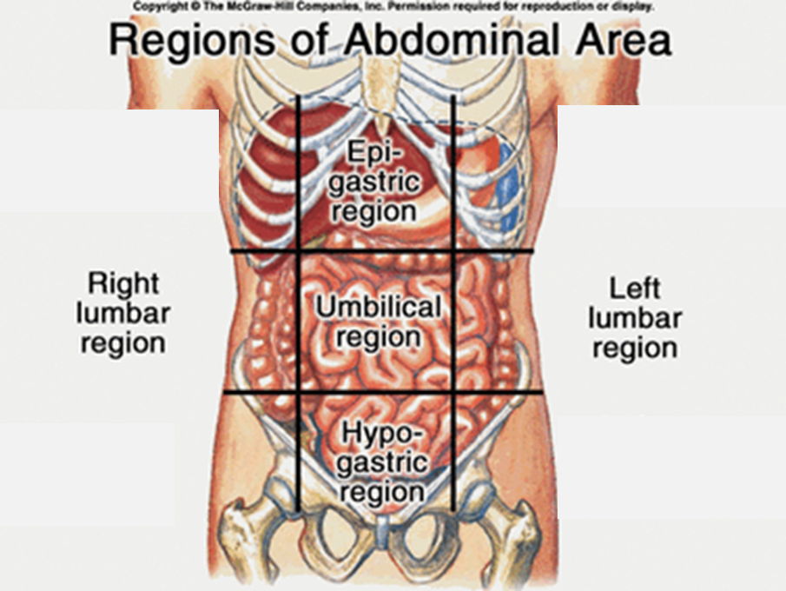
Lateral to the Umbilical
Left Lumbar
Kidney, small intestine, large intestine
Right Lumbar
Kidney, small intestine, large intestine

Slide 20
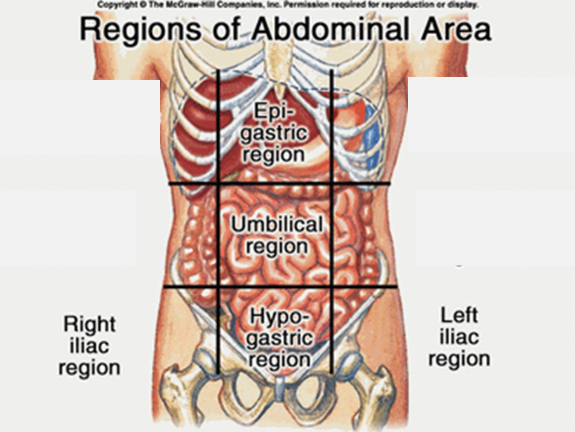
Lateral to the Hypogastric
Right Iliac Region
Small and Large Intestine
Left Iliac Region
Small and Large Intestine

Slide 21
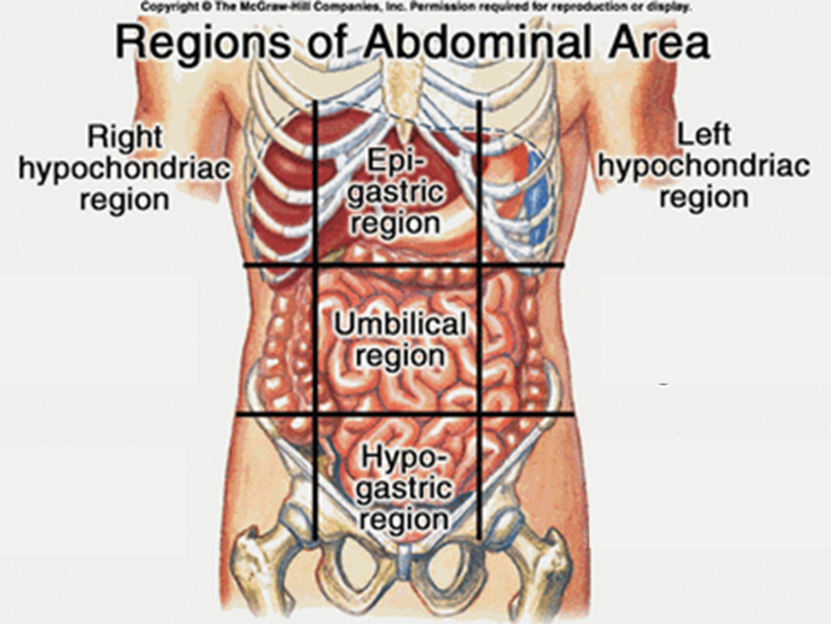
Lateral to the Epigastric
Right Hypochondriac Region
Liver, Gallbladder
Left Hypochondriac Region
Small Intestine, Large Intestine, Pancreas

Slide 22
9 Abdominopelvic Regions

Slide 23
Review for the Test
The Unit 1 test will be on Wednesday 9/13/17
What you need to know…
Body Regions (Diagram Dude)
Relative Positions
Body Planes
Body Cavities
Homeostasis
10 Characteristics of Life
5 Requirements of Organisms
9 Abdominopelvic Regions

Slide 24
Questions?
Next class we will be doing a review, so you need to look over everything we have studied so far in this class to prepare.
Any questions you have today or over the weekend you can put into this google form that I have created, and we will cover this during the review day.
You need to submit 1 question before the end of class TODAY
https://goo.gl/forms/7DW8NBetIEufcf7F2

Slide 25
Review Questions
Side A- White Board
Side B- Towards the Fridge
Side C- Tank/Back of the Room
Side D- Towards the Desks

Slide 26
Which of these processes illustrates positive feedback?
Increase in respiratory rate during exercise
Shivering when body temperature decreases
Increase in uterine contractions when uterine stretching increases during childbirth
All of these

Slide 27
A term that means “away from the midline”
Distal
Lateral
Medial
Superior

Slide 28
The scapula is ___________ to the lung
Dorsal
Posterior
Superficial
All of these

Slide 29
Which of these anatomical terms refers to the ankle?
Digital
Femoral
Carpal
Tarsal

Slide 30
The only plane that can divide the body into 2 equal halves is the
Mid-sagittal Plane
Coronal Plane
Sagittal Plane
Transverse Plane

Slide 31
The opposite of superior is
Lateral
Ventral
Inferior
Superficial

Slide 32
Which of the following is NOT a necessary human life function?
Assimilation
Excretion
Responsiveness
Adaptation

Slide 33
Which of the following is NOT a requirement for organisms to survive?
Food
Pressure
Water
Carbon Dioxide

Slide 34
The ability to sense changes in the environment and respond to them in a physiological ability is know as…
Excretion
Responsiveness
Metabolism
Digestion

Slide 35
This Region is… Inferior to the femoral Superior to the crural Posterior to the patellar
Patellar
Tarsal
Popliteal
Axillary

Slide 36
This region is… Medial to the coxal Superior to the pelvic Anterior to the lumbar Inferior to the celiac
Umbilical
Abdominal
Brachial
Lumbar

Slide 37
Which of the following cavities are in the Dorsal Cavity?
Cranial and Thoracic
Abdominal and Pelvic
Vertebral and Cranial
Abdominal and Vertebral

Slide 38
Send me your questions on your laptop or phone right now
https://goo.gl/forms/7DW8NBetIEufcf7F2

