Slide 1
Connective Tissue
Anatomy and Physiology

Slide 2
Connective Tissue
Functions:
  Connects, supports, protects, provides frameworks, fills spaces, stores fat, produces blood cells, protects against infection, and helps repair damaged tissues
Connective tissue has a lot of intercellular matrix between them which consists of fibers
Notes:
Connective tissue is a term used to describe the tissue of mesodermal origin that that forms a matrix beneath the epithelial layer and is a connecting or supporting framework for most of the organs of the body.

Slide 3
Connective Tissue
Major cell types
  Fibroblasts (most common cells in connective tissue)
  Macrophages
  Mast cells
Connective Tissue Fibers
  Collagenous fibers
  Elastic fibers
  Reticular fibers
Notes:
Fibroblasts- these cells produce fibers by secreting proteins into the matrix of connective tissues (These are the most common cells in connective tissue
Macrophages- these originate as white blood cells. Specialized to carry on phagocytosis. They can function as scavenger and defense cells that clear foreign particles from tissues. (Phagocytosis- a cell engulfs a substance)
Mast cells- located near blood vessels. They release heparin which prevents blood clotting and histamine which is associated with allergies and inflammation
Collagenous fibers- thick threads of protein collagen. They are grouped in long parallel bundles and are flexible but only slightly elastic. They have good tensile strength (they resist pulling forces). They hold together ligaments and tendons
Elastic fibers- composed of elastin. Thin fibers that form complex networks. These are weaker than collagenous fibers but they stretch easily. Common in the vocal cords
Reticular fibers- thin collagenous fibers that are highly branched and support a variety of tissues
Think about collagenous fibers as being really thick and elastic fibers as being really thin.

Slide 4
Loose Connective Tissue
Forms delicate thin membranes throughout the body.
The cells are located far apart and are connected by a gel-like matrix
Function: bind organs together, hold tissue fluids
Location: Beneath skin, between muscles, beneath epithelial tissues
Notes:
This gel-like matrix contains collagenous and elastic fibers (which are secreted by the fibroblasts). The fibroblasts are just the cells that secrete the fibers.

Slide 5
Adipose Tissue
“Fat”
Function: Protect, insulate, store fat
Location: Beneath skin, around kidneys, behind eyeballs, on surface of heart
This develops when certain cells store fat in droplets within their cytoplasm and enlarge. Many of these cells make up adipose tissue.
Notes:
Overeating and lack of exercise increases the size of adipose cells. (Overweight, obesity)
When someone fasts, fat supplies the energy, so the adipose cells lose fat and shrink to become more like fibroblasts.
This connective tissue develops when certain cells store fat in droplets within their cytoplasm and enlarge. When there are a lot of these cells, there is adipose tissue.
Location: Beneath the skin between muscles, around the kidneys, behind the eyeballs, abdominal membranes, surface of heart, certain joints.
Function: cushions joints and organs (kidneys), insulate the skin, stores energy in fat molecules.

Slide 6
Dense Connective Tissue
Closely packed, thick, collagenous fibers, fine network of elastic fibers.
Very few cells (fibroblasts)
The collagenous fibers are strong which allows it to be pulled.
Function: Binds organs together
Location: tendons, ligaments, deeper layers of skin
Notes:
Location: bind body parts together as tendons and ligaments, white of the eyeball, deep skin layers
Fun fact: Low blood supply to dense connective tissue, so it is slow for this tissue to repair

Slide 7
Cartilage
Rigid connective tissue
Function: support, framework, attachment, protect underlying tissues, form structure for developing bone
Composed of collagenous fibers
Lack of a direct blood supply to cartilage tissue, torn cartilage heals very slowly and their cells (chondrocytes) do not divide easily
  3 Types of cartilage
    Hyaline cartilage
    Elastic cartilage
    Fibrocartilage

Slide 8
Hyaline cartilage
Most common type of cartilage!
Made up of fine collagenous fibers
Important for growth of bones
Function: supports, protects, provides framework
Location: nose, ends of bones, rings in the wall of the respiratory passage
Notes:
Location: ends of bones in joints, soft part of nose, supporting rings of respiratory passages

Slide 9
Elastic Cartilage
Many elastic fibers
More flexible than hyaline cartilage
Function: supports, protects, provides flexible framework
Location: Framework of external ear and parts of the larynx
Notes:
Location: external ear, parts of the larynx
Function: framework

Slide 10
Fibrocartilage
Tough tissue, contains thick collagenous fibers
Function: Supports, protects, absorbs shock
Location: Between bony parts of spinal column, parts of pelvic girdle and knee
Notes:
Function: shock absorber for structures that have a lot of pressure placed on them
Location: intervertebral disk pads of the spinal column, knees, pelvic girdle

Slide 11
Bone
Most rigid connective tissue
Hard due to mineral salts
It’s matrix contains a lot of collagen (the fibers flexibly reinforce the mineral components of bone)
Function: Supports, protects, provides framework
Location: Bones of the skeleton
Notes:
Mineral salts include calcium phosphate, calcium carbonate between cells.
These inorganic molecules include calcium and phosphorous
Function: support body structures
Location: cranial and thoracic cavities, attachment for muscles
Bone cells are called osteocytes.
Bone tissue has these concentric circles that can be seen.
Contains red marrow which forms blood cells and stores are releases inorganic molecules

Slide 12
Blood
Function: transports substances, helps maintain stable internal environment
Location: Throughout the body within a closed system of blood vessels and heart chambers.
Notes:
Function: transports a variety of materials between interior body cells and those that exchange substances with the external environment.

Slide 13
Identify the tissue Type

Slide 14
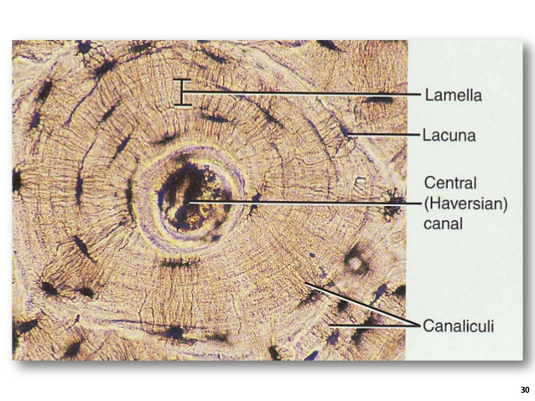
Bone

Slide 15
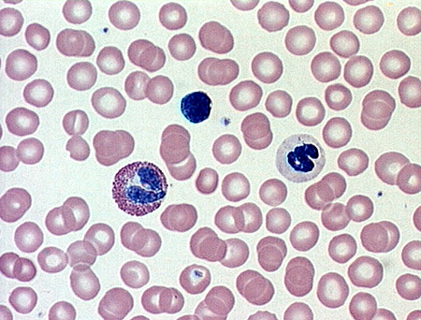
Blood

Slide 16
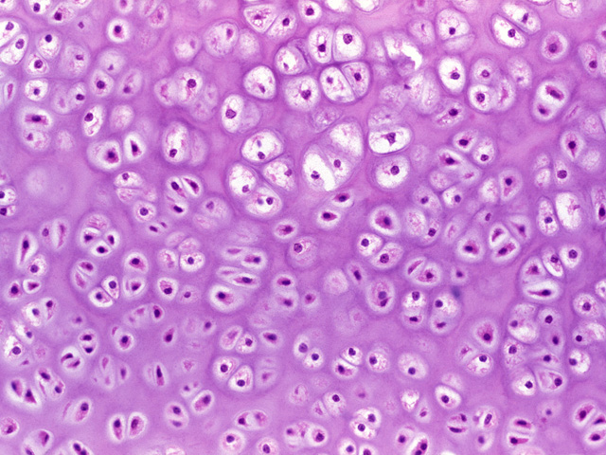
Hyaline Cartilage

Slide 17
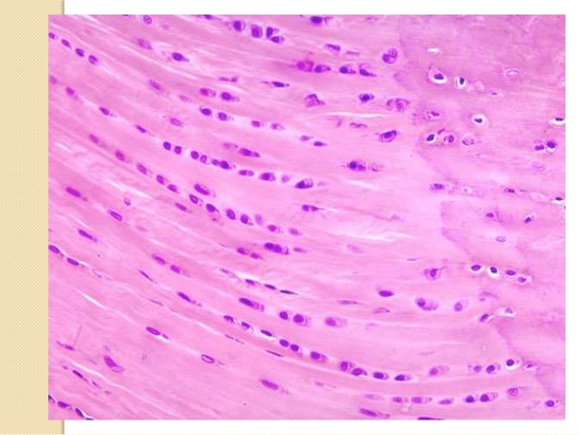
fibrocartilage

Slide 18
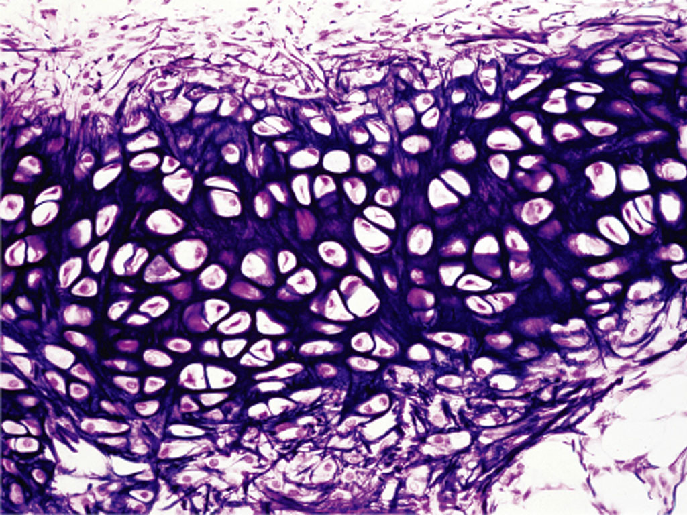
Elastic cartilage

Slide 19
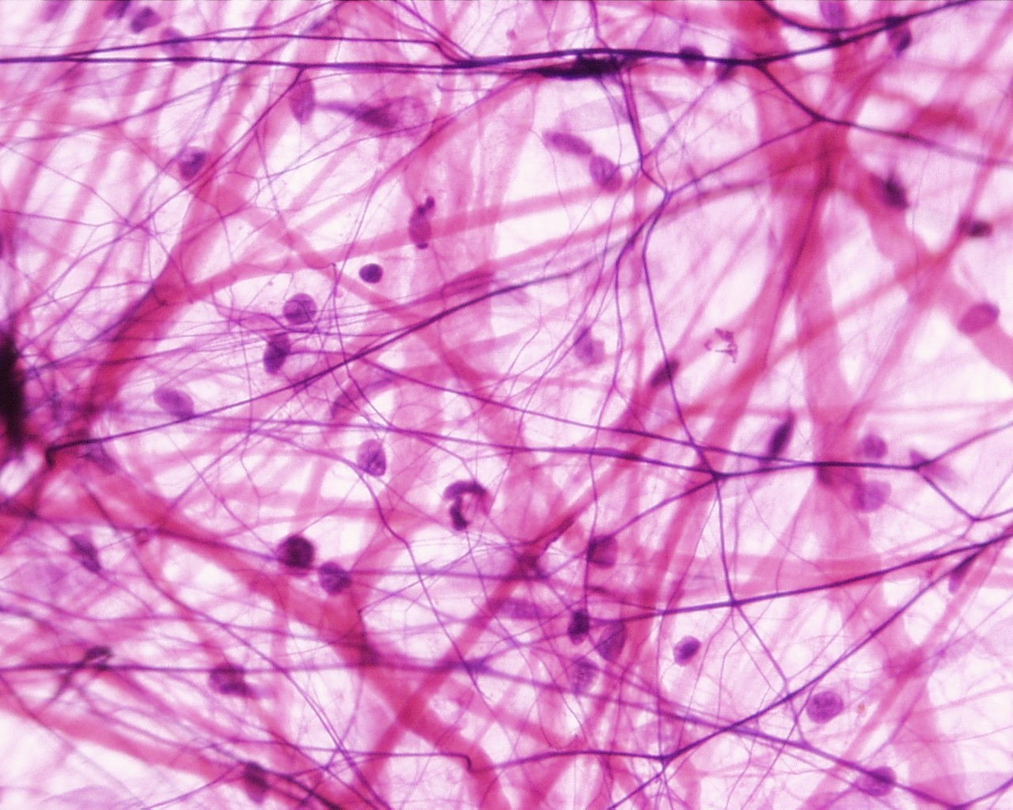
Loose connective tissue

Slide 20
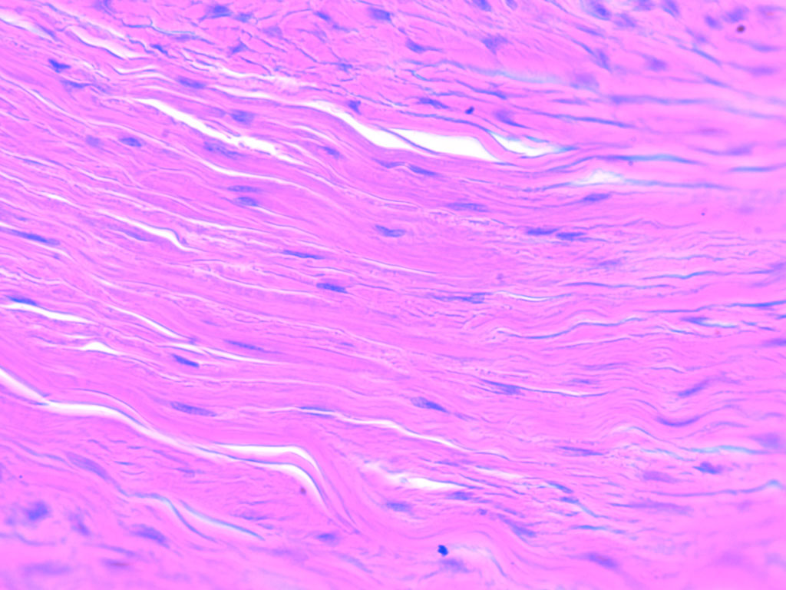
Dense connective tissue

