Slide 1
Glandular Epithelium
Anatomy and Physiology

Slide 2
Glandular epithelium
Composed of cells that are specialized to produce and secrete substances into ducts or into body fluids

Slide 3
What is a gland
an organ in the human or animal body that secretes particular chemical substances for use in the body or for discharge into the surroundings.

Slide 4
What is a duct?
A tubular bodily canal or passage, especially one for carrying a glandular secretion

Slide 5
Exocrine Glands
Glands that secrete their products into ducts that open onto some internal or external surface
Notes:
Include sweat and oil glands
Empty through ducts to the epithelial surface

Slide 6
Endocrine Glands
Glands that secrete their products into tissue fluid or blood
Notes:
No duct, ductless
Secretions are hormones which we will talk about later on in the year.

Slide 7
Types of Exocrine Glands
Merocrine Glands- glands that release watery, protein-rich fluids by exocytosis
Apocrine Glands- glands that lose small portions of their glandular cell bodies during secretion
Holocrine Glands- those in which the entire cell lyses during secretion
Notes:
Apocrine (a piece of cell)
Holocrine (whole cell)

Slide 8
Exocrine Glands
Most exocrine glands are merocrine, which can be classified as either serous or mucous cells.
Serous cells: watery and has a high concentration of enzymes. They are common in the linings of the body cavities
Mucous cells: secrete a thicker fluid called mucus. It is secreted from the inner linings of the digestive and respiratory system

Slide 10
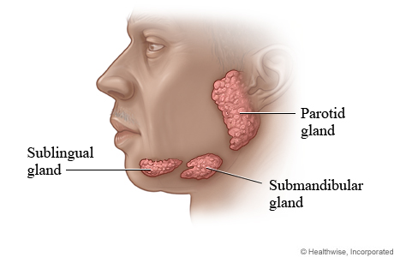
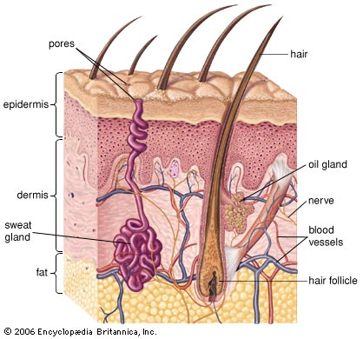
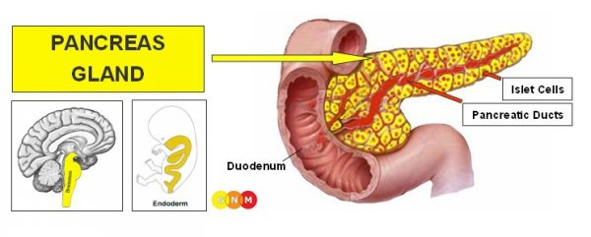
Merocrine Glands
Release secretions without losing cytoplasm
Examples:
Salivary glands
Pancreatic glands
Sweat glands of the skin
Notes:
Salivary gland- produce saliva which moistens the mouth to help a person chew
Pancreatic glands- secretes enzymes to break down the proteins, lipids, carbohydrates, and nucleic acids in foods
Sweat glands in skin- sweat is released from the sweat glands to cool the surface of the skin

Slide 11
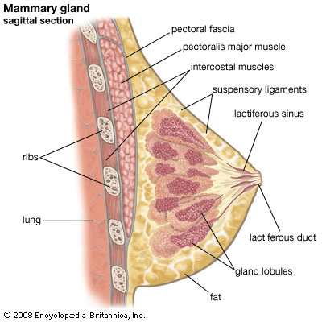
Apocrine Glands
Lose small portions of their cell bodies during secretion
Example:
Mammary glands
Ceruminous glands lining the external ear canal
Notes:
Mammary glands- located in the breast of both male and females and is responsible for the secretion of milk
Ceruminous glands- modified sweat glands found in the external auditory canal (they produce ear wax to help trap foreign particles from reaching the eardrum)

Slide 12
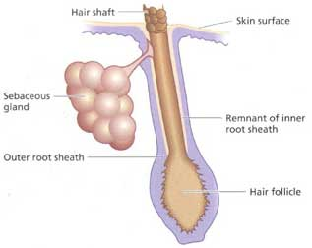
Holocrine Glands
Release entire cells filled with secretary products
Examples:
Sebaceous glands of the skin
Notes:
Sebaceous glands- they secrete an oily or waxy secretion called sebum to lubricate and waterproof the skin and hair of mammals

Slide 13
Connective Tissue
Functions:
Connects, supports, protects, provides frameworks, fills spaces, stores fat, produces blood cells, protects against infection, and helps repair damaged tissues
Connective tissue has a lot of intercellular matrix between them which consists of fibers
Major cell types
Fibroblasts
Macrophages
Mast cells
Connective Tissue Fibers
Collagenous fibers
Elastic fibers
Reticular fibers
Notes:
Fibroblasts- these cells produce fibers by secreting proteins into the matrix of connective tissues
Macrophages- these originate as white blood cells. Specialized to carry on phagocytosis. They can function as scavenger and defense cells that clear foreign particles from tissues. (Phagocytosis- a cell engulfs a substance)
Mast cells- located near blood vessels. They release heparin which prevents blood clotting and histamine which is associated with allergies and inflammation
Collagenous fibers- thick threads of protein collagen. They are grouped in long parallel bundles and are flexible but only slightly elastic. They have good tensile strength (they resist pulling forces). They hold together ligaments and tendons
Elastic fibers- composed of elastin. Thin fibers that form complex networks. These are weaker than collagenous fibers but they stretch easily. Common in the vocal cords
Reticular fibers- thin collagenous fibers that are highly branched and support a variety of tissues

