Slide 1
Integumentary System
Skin, Hair, Nails, Exocrine Glands

Slide 2
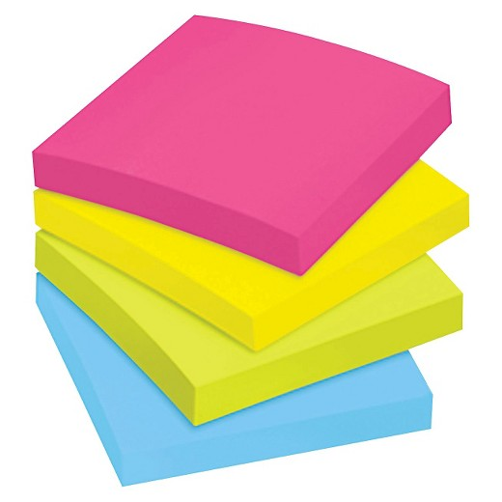
Sticky Notes!
Write one thing per sticky note. You may use as many sticky notes as you need. Can be complete sentences or just a word/phrase.
Once you have written sticky notes put them on the board in the categories.
Categories include…
Functions
Locations
Basic Facts
Interesting Facts
Questions you have!

Slide 3
What is an organ?
2 or more kinds of tissues grouped together
The skin is the largest organ in the human body, so it is made up of many tissues…
Stratified squamous epithelial tissue
Connective tissue
Adipose tissue
Loose connective tissue
Smooth muscle tissue
Nervous tissue

Slide 4
What is the Integumentary System?
The skin and its accessory organs.
The integumentary system includes…
Hair
Nails
Skin
Sweat Glands
Oil Glands

Slide 5
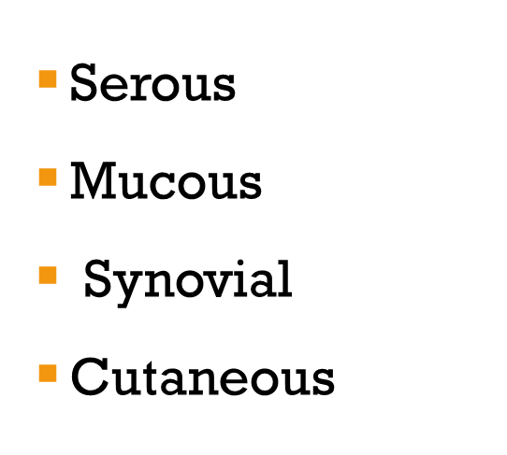
4 Types of Membranes
Serous
Line body cavities that LACK openings to the outside
A layer of simple squamous epithelium and a thin layer of loose connective tissue
Locations: inner lining of thorax and abdomen, cover organs within these cavities
Secrete watery serous fluid
This lubricates the membrane surface
Mucous
Line cavities and tubes that open to the outside of the body
Epithelium overlaying a layer of loose connective tissue
Locations: Oral and nasal cavities, tubes of digestive, respiratory, urinary, and reproductive systems
Secrete mucus
Serous
Mucous
Synovial
Cutaneous
Synovial
Inner linings of the joint cavities between the ends of bones at freely movable joints (Synovial Joints)
Dense connective tissue overlaying a layer of loose connective tissue and adipose tissue
Secrete thick colorless synovial fluid
Secreted into joint cavity and lubricates the ends of bones
Cutaneous
External body covering
SKIN!

Slide 6
Functions of Skin
Maintaining Homeostasis
Protective Covering
Regulate body temperature
Delay/prevent excessive water loss from deeper tissues
Houses the sensory receptors
Synthesizes biochemicals
Excretes small quantities of waste

Slide 7
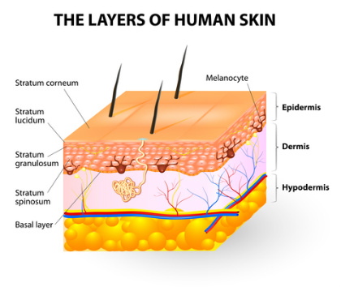
Layers of the Skin

Slide 8
Epidermis
Made up of stratified squamous epithelium
“The Outer Layer”
Function: Protection
Shields moist underlying tissues against excessive water loss
Against mechanical injury and effects of harmful chemicals
Keeps out disease-causing microorganisms if there are no breaks in the skin
Basement membrane separates the epidermis and the dermis

Slide 9
Dermis
Made up of connective tissue (collagenous + elastic fibers), epithelial tissue, nervous tissue, blood
“The Inner Layer”
This is thicker than the epidermis
Network of fibers make it tough and elastic
Blood vessels supply nutrients in skin cells. Help regulate body temperature
Nerve fibers throughout dermis carry impulses
Contains:
Hair follicles
Sebaceous glands
Sweat glands

Slide 10
Subcutaneous/ Hypodermis
Made up of loose connective tissue and adipose tissue
“The Deeper Layer”
It binds the skin to underlying organs
The fibers are continuous with the dermis, so there is no boundary between the dermis and hypodermis
Adipose insulates, conserves body heat, prevents entrance of heat from the outside
Contains major blood vessels that supply the skin and adipose tissue

Slide 11
Layers of Skin
Stratum Corneum
Layer of flat dead cells filled with keratin
Stratum Basale
Single layer of cuboidal and columnar cells that undergo mitosis and become the cells of more superficial layers
This is where cell-division is occuring

Slide 12
Dividing Cells
Stratified squamous epithelial cells divide closer to the dermis where there is a blood supply and then are pushed closer to surface as they get older
Closer to the surface = Further from nutrient source
So they die
The process of old cells hardening is…
KERATINIZATION
Keratin is a protein that is tough, fibrous, waterproof

Slide 13
Melanocytes
Cells that produce melanin
Melanin
Dark pigment that provides skin color
Difference in skin color due to different amounts of melanin produced by melanocytes, even though everyone has the same number of melanocytes
Melanocytes are located in the deeper cells of epidermis and connective tissue of the dermis
It absorbs light energy to protect the deeper cell layers of UV radiation in the sun
Skin color is mostly genetic, but environmental and physiological factors can influence skin color.
Darker skin color is due to an abundant production of melanin.
Notes:
Environmental factors: sunlight, sun lamps, x-rays (exposure to UV and X radiation)
Physiological factors: blood vessels beneath the skin dilated or not causing skin to be reddish in appearance. Or things like eating carrots. Which are high in beta-carotene so they cause you to look yellow mainly on your palms and soles
Sunburn- intense UV exposure. The redness is an inflammatory response as a result of dilation of blood vessels. The skin looses moisture and hydration which leads to tightness. Eventually the skin cells will thicken and melanin will be produced to attempt to stop the UV rays from penetrating through deeper layers of skin and damaging the DNA of cells. If the DNA is damaged it can lead to cancer. Your skin peels to get rid of those dead skin cells.

Slide 14
Hair
Hair is composed of dead epidermal cells
Location: All surfaces of skin
Except:
Palms
Soles
Lips
Nipples
Parts of external reproductive structures
Hair follicle
Where hair develops from; tube-like depression; extend from surface into dermis
Arrector Pili Muscle
Bundle of smooth muscle cells attached to each hair follicle
Short hair in follicle stands on end when the muscle contracts
If someone is sad or cold the arrector pilus muscle contracts causing goosebumps.

Slide 15
Hair Color
Notes:
Dark Hair- a lot of melanin
Blond Hair- intermediate amount of melanin
White Hair- no pigment
Red Hair- has trichosiderin which is only present in this hair color

Slide 16
Sebaceous Glands
What type of glands are these?
Holocrine Glands
They secrete sebum; an oily mixture of fatty material and cellular debris
Sebum keeps the skin soft, pliable, and waterproof

Slide 17
Nails
Location: On the ends of fingers and toes
They are keratinized stratified squamous epithelial cells with very hard keratin
Notes:
Nail root: in nail’s proximal end
Lunula: a half-moon shaped area at the base of the nail; most active growing region
Nail bed: outer layer of epithelium where the nail stays attached

Slide 18
Sweat Glands
Exocrine glands
Tiny tubes that originate as ball-shaped coil in deeper dermis or superficial subcutaneous layer; the coiled portion is closed and lined with sweat-secreting epithelial cells
They respond to body temperature and environmental heat or exercise.
Sweat is carried away through a duct that opens to the surface (this is called a PORE)
Sweat: Mostly water, but small amount of salt and wastes (such as urea and uric acid)
Eccrine: the main sweat glands (most numerous)
Apocrine: active when person is upset, frightened, or in pain (Most numerous in axillary regions and groin; usually connect to hair follicles)

Slide 19
Nerve Receptors
Pacinian Corpuscle
Detects vibrations and heavy touch sensations and send impulses off to the brain.
Meissner’s Corpuscle
Detect light touch sensations and dispatch impulses for interpretation

Slide 20
Skin Disorders & Conditions Project
You can work individually or with a partner.
You will be working on this project during class and will be sharing your information with your classmates using a Piktochart
You can sign-up for a free account
You need at least 4 citations in MLA format

Slide 21
Skin Topics
Acne
Alopecia areata
Athlete’s foot
Birthmarks
Psoriasis
Ringworm
Rosacea
Shingles
Warts
Burns
Eczema
Herpes
Keloid scar
Leprosy
Melanoma
Moles

