Slide 1
Muscle & Nervous Tissue
Anatomy & Physiology

Slide 2
Muscle Tissue
Made up of elongated cells that can contract (shorten)
There are 3 types of muscle tissue
Skeletal Muscle Tissue
Smooth Muscle Tissue
Cardiac Muscle Tissue

Slide 3
Skeletal Muscle Tissue
Location: Muscles usually attached to bones
Function: Voluntary movement of skeletal parts
Voluntary movement- movement we can control by conscious effort
Made up of long threadlike cells that have alternating light and dark markings, these are called striations
Notes:
When stimulated by a nerve impulse, the muscle fiber contracts and then relaxes.
Muscles that have skeletal muscle tissue move the head, trunk, limbs
Allow us to make facial expressions, write, talk, sing, chew, swallow, and breathe

Slide 4
Smooth Muscle Tissue
Location: walls of hollow internal organs
Function: Involuntary movements of internal organs
Smooth- its cells lack striations
Shorter than skeletal muscle
Spindle-shaped with a single nucleus in the center
Notes:
Examples of hollow internal organs: stomach, intestines, urinary bladder, uterus, and blood vessels.
Involuntary movements- we do not control these muscles, they unconsciously work
This moves food through the digestive tract, constricts blood vessels, and empties the urinary bladder

Slide 5
Cardiac Muscle Tissue
Location: Heart
Function: heart movements
Striated cells are joined end-to-end
Branched and connected muscle fibers
Involuntary movement
Notes:
Makes up the bulk to the heart and pumps blood through the heart chambers and into blood vessels

Slide 6
Cell Division in the Tissues
Continuously divide
Epithelial cells of the skin
Epithelial cells of the inner lining of digestive tract
Connective tissue cells in red bone marrow
Do not divide after differentiation
Striated and cardiac muscle cells
Notes:
Fibroblasts repond to injuries rapidly by increasing in number and increasing fiber production.
When someone has a heart attack, damage may be done to the cardiac muscle. This tissue is replaced by connective tissue which is formed by the fibroblasts, so this will appear as a scar later.

Slide 7
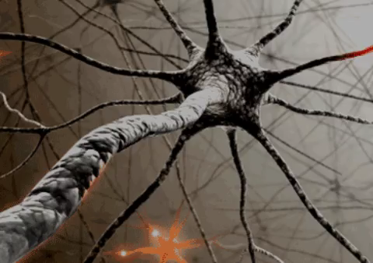
Nervous Tissues
Location: Brain, spinal cord, peripheral nerves(motor and sensory nerves that connect the brain and spinal cord)
Function: sensory reception and conduction of nerve impulses
Neurons- transmit nerve impulses
Neuroglial Cells
Notes:
The cells are called neurons
These neurons will sense a change in the surroundings and then will respond by transmitting a nerve impulse along the nerve fibers to other neurons or to muscles or glands to respond.
They are in charge of regulating, integrating, and correlating many bodily functions.
Neuroglial cells are cells that support and bind the components of nervous tissue, and connect neurons to blood vessels to help supply nutrients

